Slide 1
Network Layer
Pavlos Grigoriadis - pgrigor@csd.uoc.gr Christina Papachristoudi - chrisp@csd.uoc.gr

Slide 2
Network Layer
Data Plane
How a router forwards the packets that arrive in its incoming interfaces to outgoing interfaces
Consists of:
Header inspection
Implemented mainly in hardware
Follows the instructions given by the Control Plane
Forwarding Table
Control Plane
How a packet is routed among the routers (end-to-end routing).
Consists of:
Implemented mainly in software
Routing Algorithms and Protocols
Routing Table
Notes:
Data Plane
Definition:
Responsible for forwarding packets that arrive on a router’s incoming interfaces to the appropriate outgoing interfaces.
Also called the forwarding plane.
Consists of:
Forwarding Table: Determines the outgoing link for each incoming packet based on its destination address.
Packet Processing Functions:
Header inspection and modification (e.g., decrementing TTL, updating checksums)
Queueing and scheduling for packets in output buffers
Packet classification (for QoS, security, etc.)
Switching Fabric: The internal network that moves packets from input to output ports.
Hardware Components:
High-speed ASICs or NPUs for line-rate packet forwarding
Buffers and queues for congestion management
Key Characteristics:
Operates in real time and at high speed
Implemented mainly in hardware for performance
Follows the instructions given by the Control Plane
—-
Perfect — here’s the Control Plane slide to pair with your Data Plane one:
Control Plane
Definition:
Responsible for deciding how packets should be forwarded.
Manages the routing logic and network intelligence behind the forwarding process.
Also called the routing plane.
Consists of:
Routing Algorithms and Protocols:
e.g., OSPF, BGP, RIP, IS-IS
Determine best paths for data packets through the network
Routing Table:
Built and maintained by routing protocols
Used to populate the forwarding table in the data plane
Signaling and Network Management Functions:
Exchange of routing updates between routers
Network configuration, monitoring, and policy enforcement
Key Characteristics:
Operates logically centralized (in SDN) or distributed (in traditional networks)
Implemented mainly in software (control logic, CPU)
Slower than the data plane but provides intelligence and adaptability
Would you like me to combine both slides into a single PowerPoint layout (e.g., “Data Plane vs Control Plane” comparison slide)? I can generate the .pptx file for you.

Slide 3
Data Plane

Slide 4
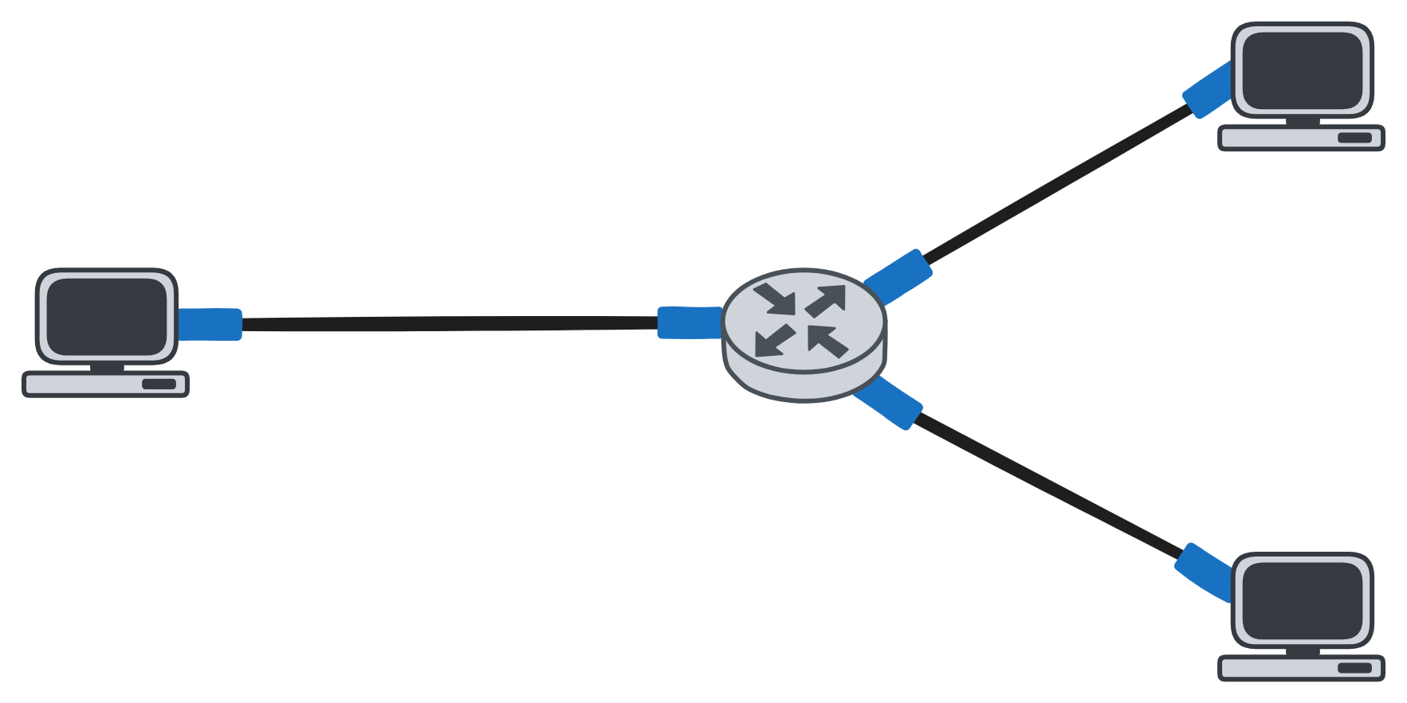
Addressing
We need a way to uniquely identify interfaces…
interface: connection between host/router and physical link

Slide 5
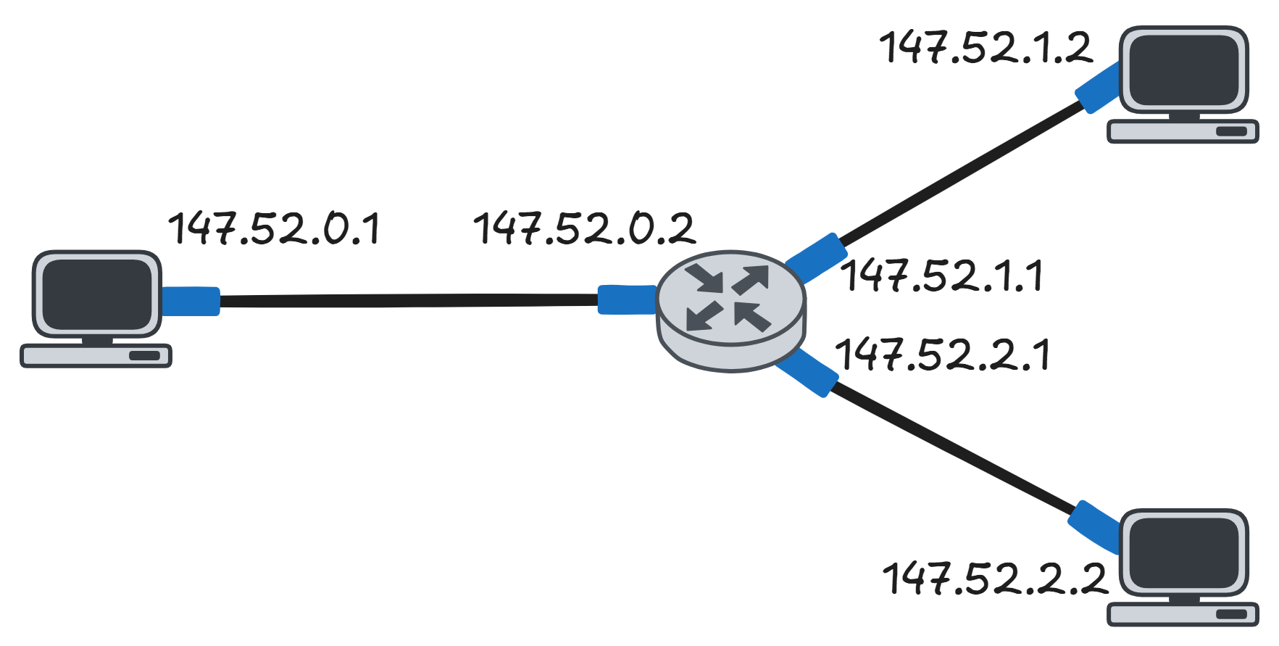
Addressing
That’s where IP comes in!

Slide 6
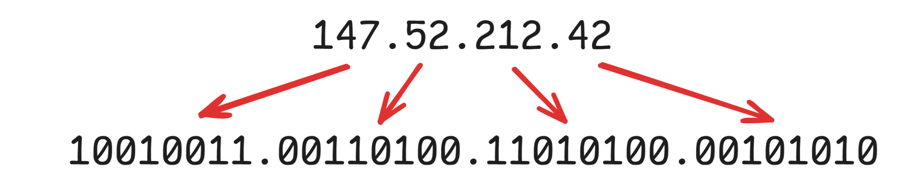
IPv4
a unique identifier for each interface
32-bits, decimal representation a.b.c.d
4 octets of 8 bits

Slide 7
IPv4
each octet is 8 bits → can represent 2⁸ = 256 numbers
so valid octets are values between 0 - 255

Slide 8
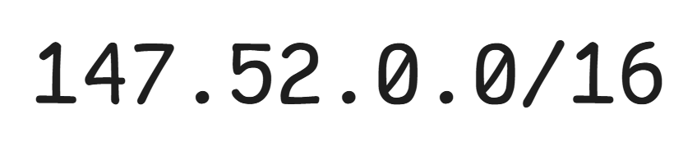
Prefixes
Each network has its own prefix
a range of IPs it can assign to its devices
a.b.c.d/x
x is the subnet mask: defines how many bits the subnet part is
the first x bits are the subnet part: is the same for all IPs inside a subnet
the rest are the host part: is unique per host

Slide 9
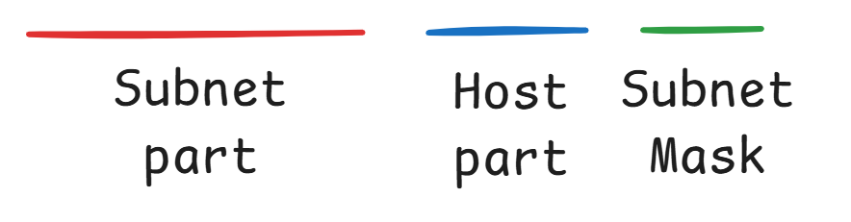
Prefixes
Each network has its own prefix
a range of IPs it can assign to its devices
a.b.c.d/x
x is the subnet mask: defines how many bits the subnet part is
the first x bits are the subnet part: is the same for all IPs inside a subnet
the rest are the host part: is unique per host

Slide 10
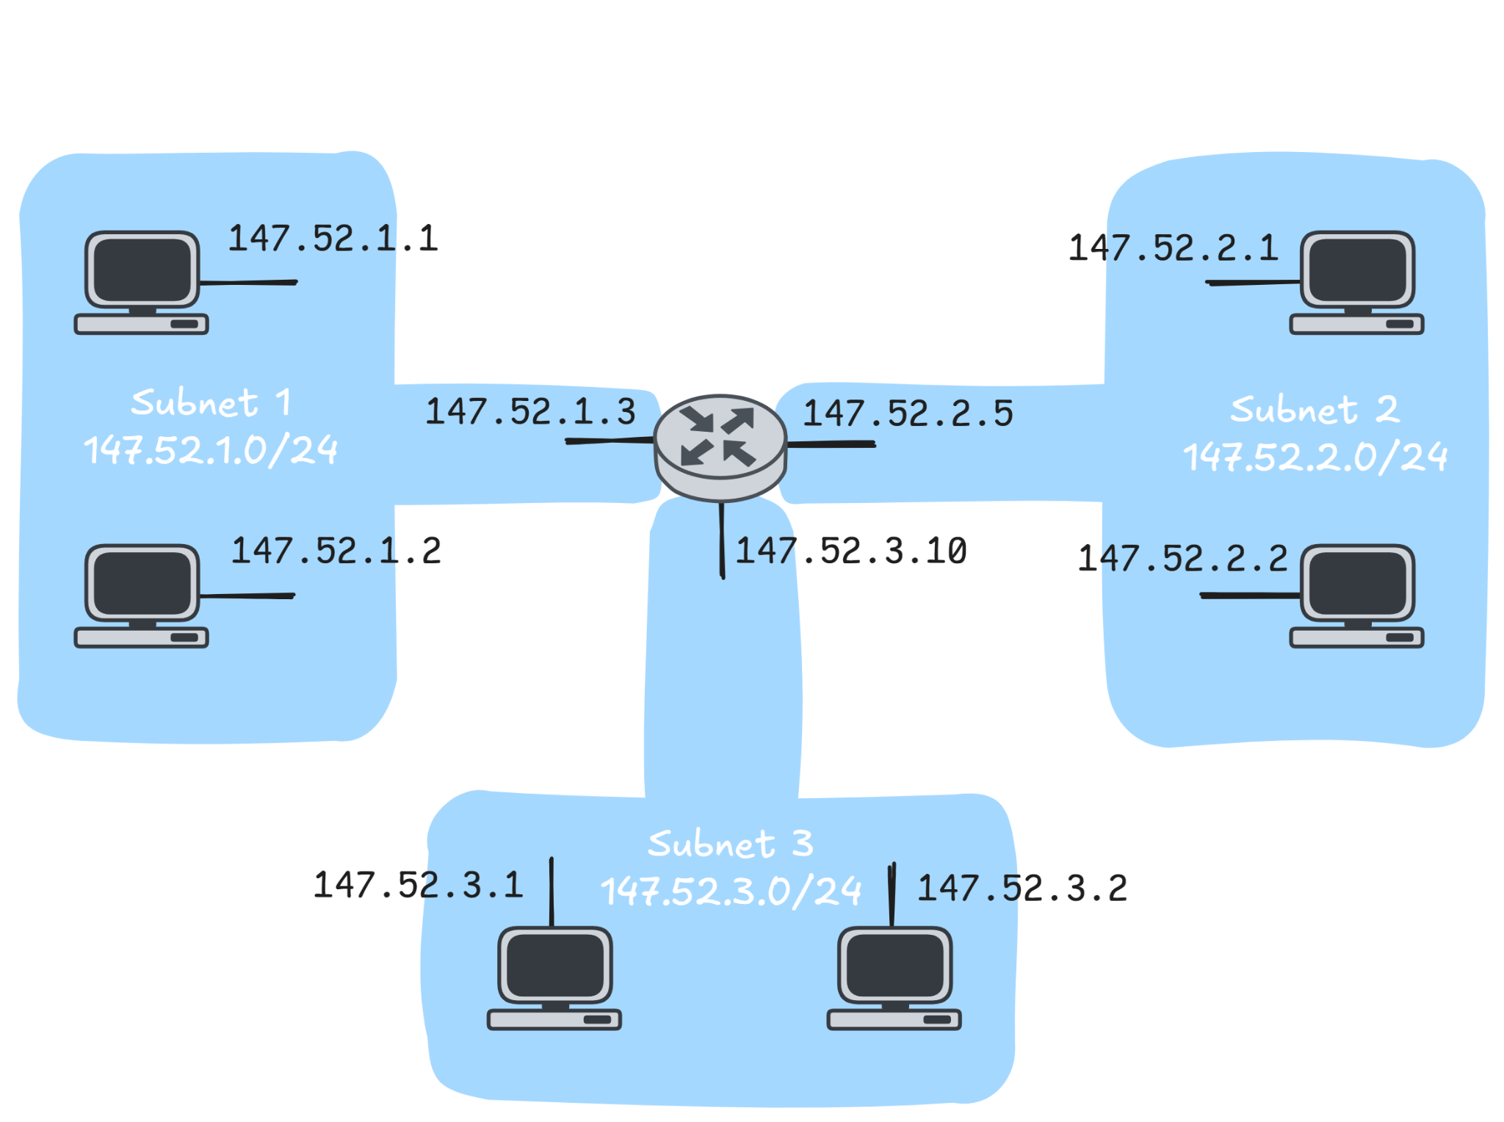
Subnet
Interfaces with same subnet part of IP address
These interfaces can physically reach each other without passing through an intervening router
inside the subnet communication happens via Link Layer

Slide 11
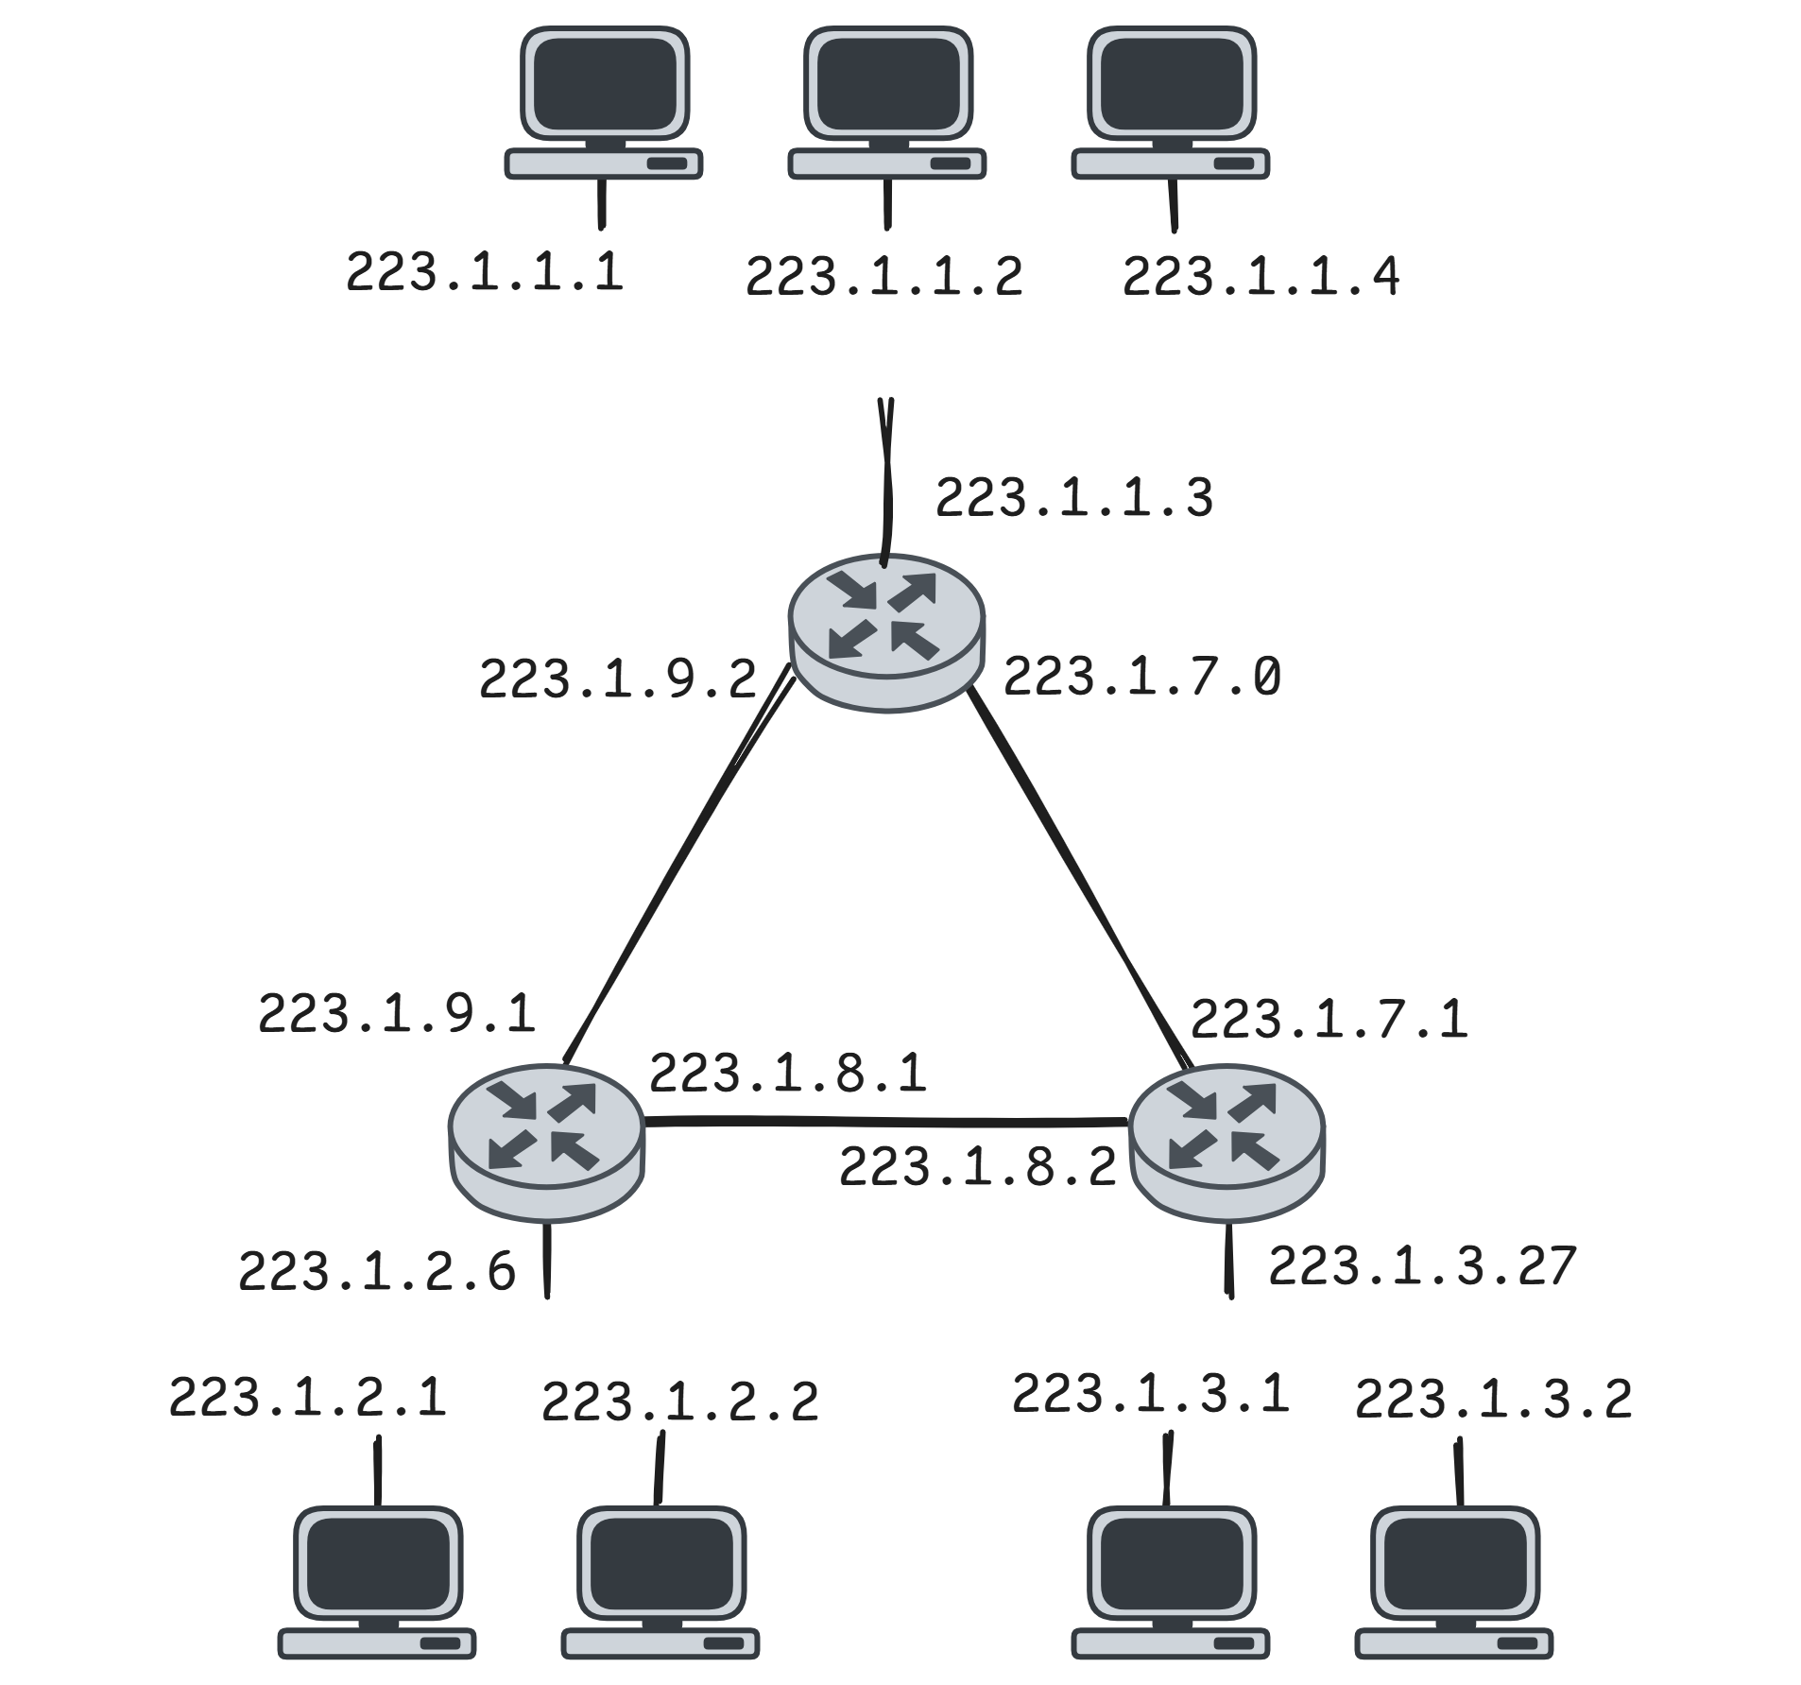
Subnets
How many subnets are here?

Slide 12
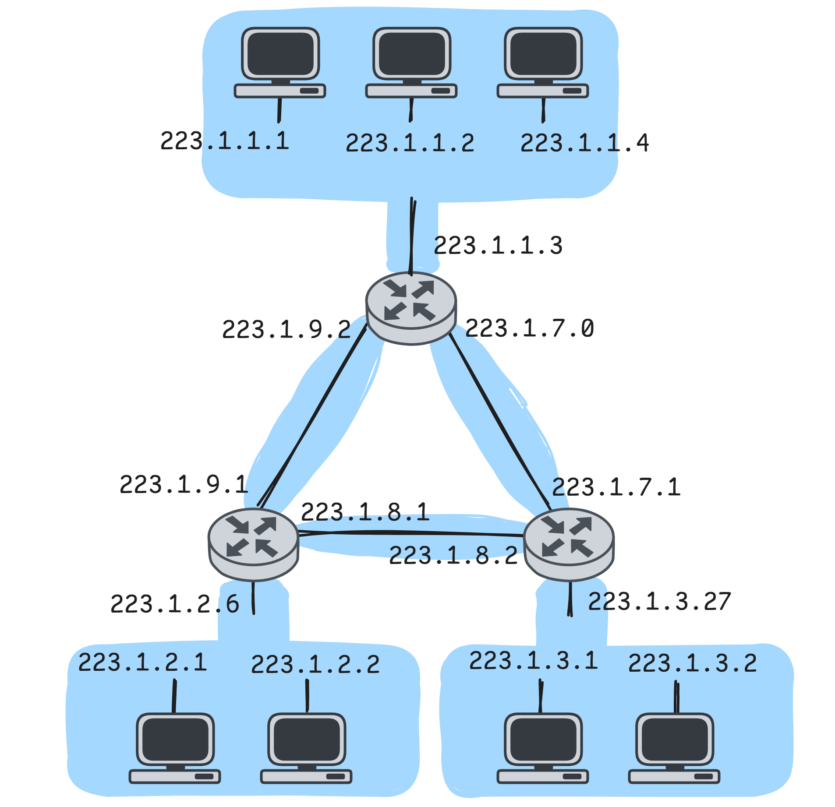
Subnets
How many subnets are here?
There are 6 subnets!
Besides the 3 subnets that contain hosts, there are the subnets that consist of the interfaces of the links between 2 routers

Slide 13
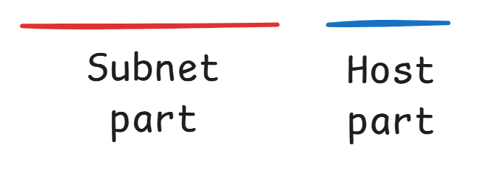
Prefixes (Continued)
There are some special IPs:
Network address: 147.52.0.0
the first IP of the network
all host part bits are 0
identifies the network
Broadcast address: 147.52.255.255
the last IP of the network
all host part bits are 1
sends the message to every device in the network
These IPs cannot be assigned to hosts
Available IPs: 2³²⁻¹⁶ - 2 = 2¹⁶ - 2

Slide 14
Subnet Mask
There is a different way to present a subnet mask besides /x.
A continuous sequence of 1s followed by 0s.
The number of 1s defines the subnet part.
11111111.11111111.1100000.00000000
We have 18 sequential 1s so a /18 mask.
In decimal format:
255.255.192.0
Other Examples:
/16 == 255.255.0.0
/24 == 255.255.255.0
/23 == 255.255.254.0
/18 == 255.255.192.0

Slide 15
Subnet Mask
Given the IP 130.5.5.25 and the mask /24 we can find the prefix:
IP: 130.5.5.25 10000010.00000101.00000101.00011001 Mask: 255.255.255.0 11111111.11111111.11111111.00000000 AND Prefix: 130.5.5.0 10000010.00000101.00000101.00000000
IP/Mask: 130.5.5.25/24 10000010.00000101.00000101.00011001 Prefix: 130.5.5.0 10000010.00000101.00000101.00000000
So we can see that the 2 notations have exactly the same meaning.

Slide 16
Subnetting
Many organizations divide their networks to smaller networks to:
Facilitate the management
Enhance the security by reducing the broadcast domains

Slide 17
Subnetting
Network with an IP prefix 223.1.17.0/24
Separate the network into two subnets
Solution:
Decimal IP | 223 | 1 | 17 | 0
Binary IP | 11011111 | 00000001 | 0010001 | 00000000

Slide 18
Subnetting
We borrow a bit from the host part and make it part of the subnet part
With n borrowed bits we can create 2^{n} subnets
Decimal IP | 223 | 1 | 17 | 0
Binary IP | 11011111 | 00000001 | 0010001 | xxxxxxxx
Original 223.1.17.0/24

Slide 19
Subnetting
We borrow a bit from the host part and make it part of the subnet part
With n borrowed bits we can create 2^{n} subnets
Decimal IP | 223 | 1 | 17 | 0
Binary IP | 11011111 | 00000001 | 0010001 | xxxxxxxx
Original 223.1.17.0/24
Decimal IP | 223 | 1 | 17 | 0
Binary IP | 11011111 | 00000001 | 0010001 | 0xxxxxxx
Subnet 1 223.1.17.0/25
Subnet 2 223.1.17.128/25
Decimal IP | 223 | 1 | 17 | 128
Binary IP | 11011111 | 00000001 | 0010001 | 1xxxxxxx

Slide 20
Subnetting
Subnet 1
Subnet 2
Prefix | 223.1.17.0/25
Available IPs for hosts | 2³²⁻²⁵ - 2 = 126
Network Address | 223.1.17.0
Broadcast Address | 223.1.17.127
Prefix | 223.1.17.128/25
Available IPs for hosts | 2³²⁻²⁵ - 2 = 126
Network Address | 223.1.17.128
Broadcast Address | 223.1.17.255

Slide 21
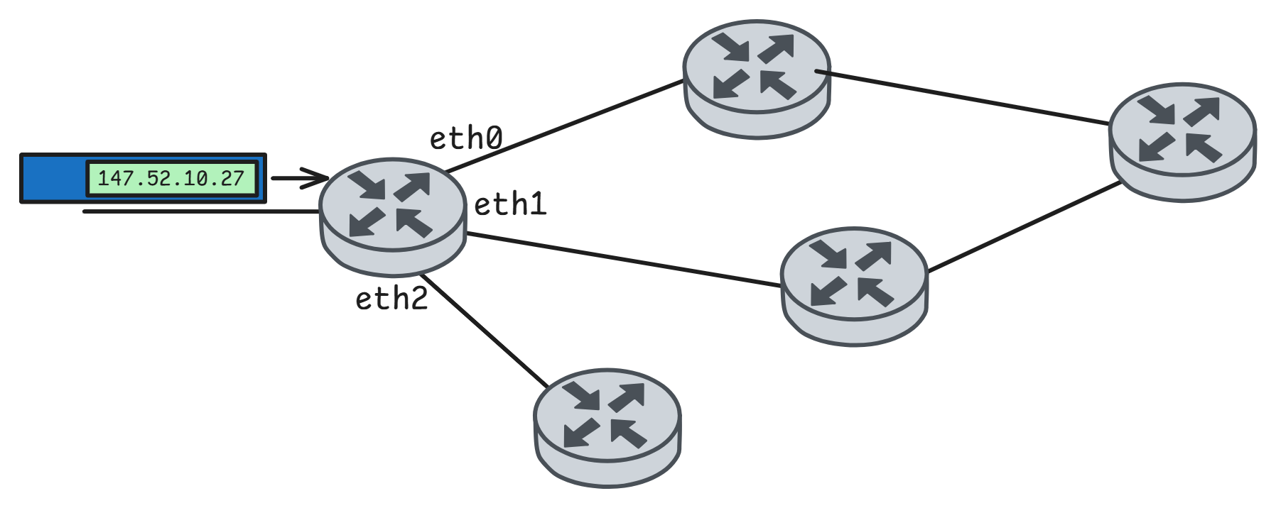
Forwarding Table
Each router has a forwarding table
The entries contain the prefixes with the corresponding output interface
The table is filled by routing algorithms
Network Destination | Output Link
147.52.0.0/16 | eth0
223.1.17.0/25 | eth2
223.1.17.128/25 | eth1
0.0.0.0/0 | eth1

Slide 22
Forwarding Table
Assume this forwarding table of a router:
Problem
From which interface will the router forward a packet with destination IP:
200.23.17.154
200.23.14.170
Network Destination | Output Link
200.23.16.0/21 | eth0
200.23.24.0/24 | eth1
200.23.24.0/21 | eth2
0.0.0.0/0 | eth2

Slide 23
Forwarding Table
We convert the IP addresses in their binary form:
200.23.17.154 → 11001000 00010111 00010001 10011010
200.23.24.170 → 11001000 00010111 00011000 10101010
Network Destination | Output Link
11001000 00010111 00010*** ******** | eth0
11001000 00010111 00011000 ******** | eth1
11001000 00010111 00011*** ******** | eth2
******** ******** ******** ******** | eth2

Slide 24
Forwarding Table
200.23.17.154 → 11001000 00010111 00010001 10011010
Network Destination | Output Link
11001000 00010111 00010*** ******** | eth0
11001000 00010111 00011000 ******** | eth1
11001000 00010111 00011*** ******** | eth2
******** ******** ******** ******** | eth2

Slide 25
Forwarding Table
200.23.17.154 → 11001000 00010111 00010001 10011010
So interface eth0
Network Destination | Output Link
11001000 00010111 00010*** ******** | eth0
11001000 00010111 00011000 ******** | eth1
11001000 00010111 00011*** ******** | eth2
******** ******** ******** ******** | eth2

Slide 26
Forwarding Table
200.23.24.170 → 11001000 00010111 00011000 10101010
Network Destination | Output Link
11001000 00010111 00010*** ******** | eth0
11001000 00010111 00011000 ******** | eth1
11001000 00010111 00011*** ******** | eth2
******** ******** ******** ******** | eth2

Slide 27
Forwarding Table
200.23.24.170 → 11001000 00010111 00011000 10101010
IP matches to more than one prefix. What happens now? 🤔
Network Destination | Output Link
11001000 00010111 00010*** ******** | eth0
11001000 00010111 00011000 ******** | eth1
11001000 00010111 00011*** ******** | eth2
******** ******** ******** ******** | eth2

Slide 28
Forwarding Table
The forwarding table follows the rule of Longest Prefix Match
When multiple prefixes match with the destination IP
the one with the most matching bits will be chosen (the longest prefix)

Slide 29
Forwarding Table
200.23.24.170 → 11001000 00010111 00011000 10101010
IP matches to more than one prefix. What happens now? 🤔
eth1 will be used because of Longest Prefix Match
Network Destination | Output Link
11001000 00010111 00010*** ******** | eth0
11001000 00010111 00011000 ******** | eth1
11001000 00010111 00011*** ******** | eth2
******** ******** ******** ******** | eth2

Slide 30
DHCP (Dynamic Host Configuration Protocol)
Allows a host to dynamically obtain an IP address when it joins the network
There is a DHCP server in each network
has an address pool
<IP, lease time> entries
is the network router in many cases
The client requests an IP from the DHCP server

Slide 31
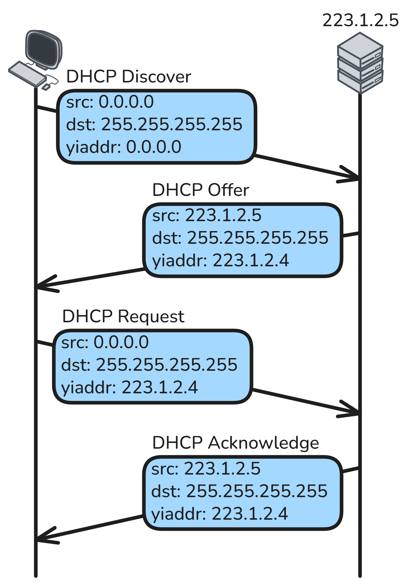
DHCP (Dynamic Host Configuration Protocol)

Slide 32

DHCP (Dynamic Host Configuration Protocol)
DORA:
Discover
Offer
Request
Acknowledge

Slide 33
DHCP (Dynamic Host Configuration Protocol)
When the lease time expires the client:
can renew the IP
get a new IP
Besides the IP the DHCP provides info about:
Lease Time
Subnet Mask
Default Gateway
The router’s IP that the client should send traffic to outside its local network
Local DNS Server

Slide 34
NAT (Network Address Translation)
As the Internet grew…
…so did the demand for IPs
IPv4s ~= 2³² = 4.3 billion addresses
As you can imagine there are not enough
Solution: NAT
Long time solution: IPv6 ~= 340,282,366,920,938,463,463,374,607,431,768,211,456 IPs

Slide 35
NAT (Network Address Translation)
Private IP ranges:
10.0.0.0/8
172.16.0.0/12
192.168.0.0/16
These IPs are not routable:
Only for communication inside a network (private network)
Routers will not forward them outside the network (to the Internet)
When we want to send traffic outside the network:
NAT translates the private IP to a public IP

Slide 36
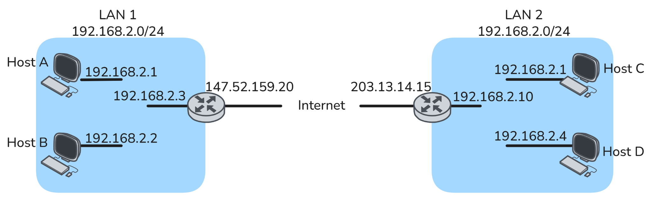
NAT (Network Address Translation)
Host A and B will communicate using private addresses
Host B will see 192.168.2.1 as src IP for packet send from host A

Slide 37
NAT (Network Address Translation)
Host A and C will communicate using public addresses
Host C will see 147.52.159.20 as src IP for packet send from host A

Slide 38
NAT (Network Address Translation)
But how does this translation happen?
NAT maps the source’s (private IP, port) to (public IP, new port)
Through the ports we can separate which host send which packet
Translation Table:
Private IP, port | Public IP, port
192.168.2.1, 5800 | 147.52.159.20, 18000
192.168.2.2, 6000 | 147.52.159.20, 12036

Slide 39
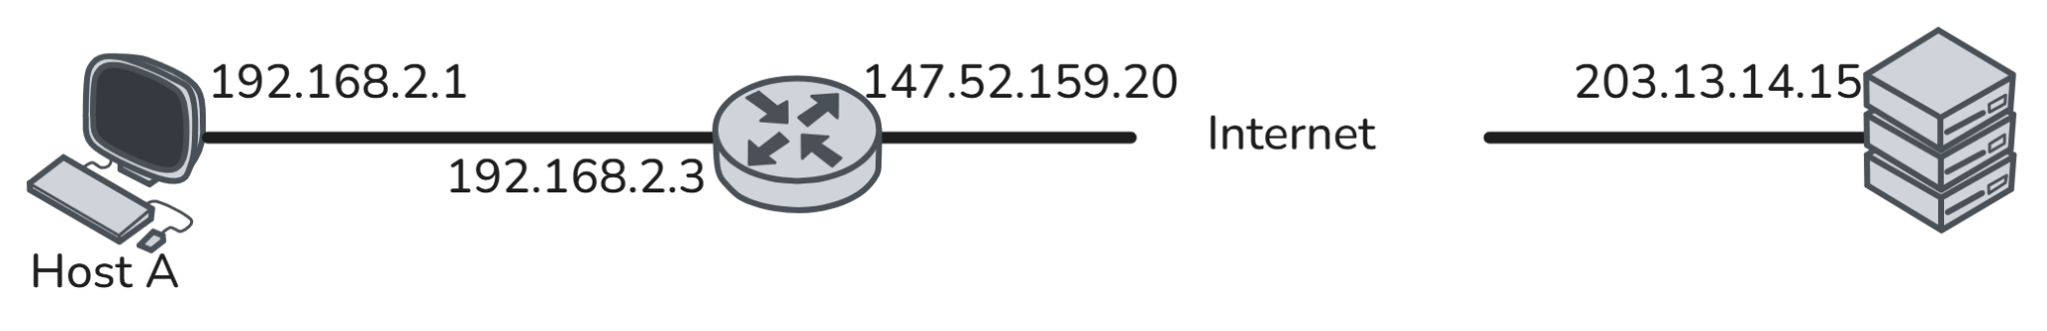
NAT (Network Address Translation)
src IP | 192.168.2.1
src port | 5800
dst IP | 203.13.14.15
dst port | 80

Slide 40
NAT (Network Address Translation)
src IP | 147.52.159.20
src port | 18000
dst IP | 203.13.14.15
dst port | 80
Store this translation to table: (192.168.2.1, 5800) → (147.52.159.20, 18000)

Slide 41
NAT (Network Address Translation)
src IP | 203.13.14.15
src port | 80
dst IP | 147.52.159.20
dst port | 18000

Slide 42
NAT (Network Address Translation)
src IP | 203.13.14.15
src port | 80
dst IP | 192.168.2.1
dst port | 5800
Map back to original IP, port (147.52.159.20, 18000) → (192.168.2.1, 5800)

Slide 43

NAT (Network Address Translation)
Notes:
👍👌

Slide 44
NAT (Network Address Translation)
What do we gain?
Conserves public IPv4 addresses
Multiple devices share one public IP.
Multiple networks can use the same private ranges (two separate organizations can both use 192.168.x.x internally without conflict)
This greatly reduces the number of public IPs a network needs.
Increases network security (basic privacy)
Internal devices are not directly exposed to the Internet.
Outside hosts cannot directly initiate connections to private IPs.
Allow easy network renumbering
We can change internal private IP ranges without affecting the public-facing address.
Notes:
What do we gain?
Conserves public IPv4 addresses
Multiple devices share one public IP.
This greatly reduces the number of public IPs a network needs.
Increases network security (basic privacy)
Internal devices are not directly exposed to the Internet. Outside hosts cannot directly initiate connections to private IPs unless port forwarding is configured.
3. Allows easy network renumbering
You can change internal private IP ranges without affecting the public-facing address.
4. Enables multiple networks to use the same private ranges
Two separate organizations can both use 192.168.x.x internally without conflict.

Slide 45
NAT (Network Address Translation)
What are the disadvantages?
Breaks end-to-end connectivity
changes the IP
another internet host will not be able to identify the specific host that sent the packet
Adds processing overhead
Complicates protocols that embed IP addresses
Makes inbound connections harder
External clients cannot reach internal devices without extra configuration
Difficulties for logging/filtering
track individual hosts
apply IP-based access rules
Notes:
1. Breaks end-to-end connectivity
Some applications expect direct access between hosts. NAT interferes with peer-to-peer apps, VoIP, gaming, etc.
2. Adds latency and processing overhead
The router must rewrite IP addresses and ports for every packet.
3. Complicates protocols that embed IP addresses
Examples:
SIP
FTP
H.323 These often require NAT helpers or ALGs.
4. Makes inbound connections harder
External clients cannot reach internal devices without:
port forwarding
UPnP
static NAT
VPN
5. Difficulties for geolocation / logging
All devices behind NAT share one public IP, making it harder to:
track individual hosts
perform accurate geolocation
apply IP-based access rules

Slide 46
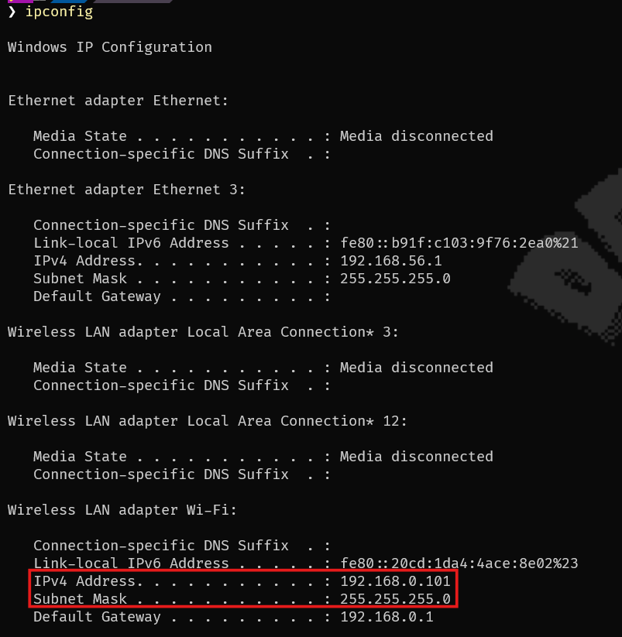
Commands to show IP
Windows: ipconfig
ipconfig /all for more info

Slide 47
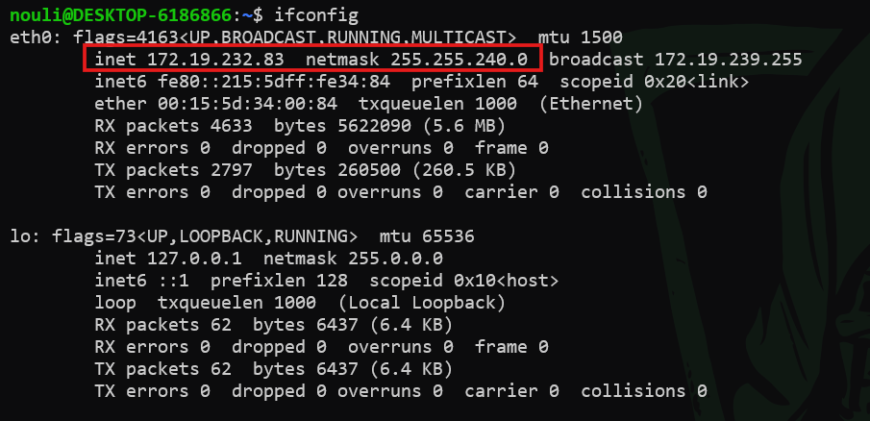
Commands to show IP
Linux/Mac: ifconfig

